Slide 1
CYBER LAW
Presented By:
Roshan Karki
Janak Tripathi
Samin k.c.

Slide 2
OBJECTIVES
Cyber Crime
Cyber law
Different cyber laws
Cyber laws in Nepal
Situation in Nepal
Advantages of Cyber law
Disadvantages of Cyber law

Slide 3
Cyber Crime
Computer crime, cyber crime, e crime, high tech crime or internet crime generally refers to criminal activity where a computer or network is the source, tool, target or the place of crime.
Cybercrimes can be defined as: "Offences that are committed against individuals or groups of individuals with a criminal motive to intentionally harm the reputation of the victim or cause physical or mental harm, or loss, to the victim directly or indirectly, using modern telecommunication networks such as Internet (networks including but not limited to Chat rooms, emails, notice boards and groups) and mobile phones (Bluetooth/SMS/MMS)“.
Cyber Crime
Based on Computer's Role
Based on the type of victim

Slide 4
Based on Computer’s Role
Computer As A Target
(e.g.. Unauthorized access to computer, malware attack Software/Hardware)
Computer Accidentally Used
(e.g. Child pornography, fraud)
Computer as a helper
(Software Piracy, copyrights infringement)
Computer As Tool
(e.g. credit card fraud, telecom fraud, spam)
Based on type of victim
Affecting Financial Health
Affecting the nation’s security
Affecting Individuals
Affecting Individual
Violation of Privacy
Identity Theft
Cyber Stalking
Spoofing
Counterfeiting

Slide 5
Forgery ad counterfeiting
Password Cracking
Hacking
Theft of Telecom Service
Piracy and Copyright Infringement
Computer Sabotage and Extortion
DOS Attack
Economic Espionage
Money Laundering
Cyber squatting
Trade Libel
Malware(Hard/Soft)
Computer or Online Fraud
Scam, Phishing Attack, Online Auction Fraud,etc

Slide 6
Cyber Law
The term “Cyberspace” was used in 1984 by the author, William Gibson in his scientific novel “Neuromancer” to describe virtual world of computer such as the internet, computers, computer network, telecommunication, etc.
Today, cyberspace has become synonymous with the Internet, however, cyberspace is known as the WWW (World Wide Web).
The cyberspace is governed by a system of law and regulation called Cyber Law.
So, the cyber law is defined as: “The law which governs the legal issues in the cyberspace regarding the Internet or the World wide web for digital data processing and transaction.”
It is less a distinct field of law than intellectual property or contract law, as it is domain covering many areas of law and regulation.
Some leading topics include internet access and usage, privacy, freedom of expression.

Slide 7
What does the cyber law incorporate?
Intellectual Property Law
Copyrights
Patent Rights
Trademarks
Privacy
Computer Crime Law
Digital Signature system
Freedom of Expression

Slide 8



Intellectual Property Law
Intellectual property is very wide and includes literature and art, films, computer programs, inventions, designs and marks used by traders for their goods or services.
The term “intellectual property” which is related to cyberspace and its various components is covered by cyber law.
It includes various laws such as: Copyright law which is related to computer software, source code; Trademark law which is related to domain names, recognizable design or sign to distinguish products or services; Patent which is a form of right granted by the government to an inventor or owner.
Notes:
C- Copyright Symbol
R- Registered Trademark
TM- Unregistered Trademark

Slide 9
Privacy (Data protection)
Data protection and privacy refers to the process of ensuring the preservation, integrity and reliability of data.
Only authenticated persons should process, copy, delete, transmit and receive the respective data and information.
To manage this system, data protection and privacy law is enacted. To perform this operation many nations have made laws relating to data protection and privacy.
It is really critical to protect the fundamental rights and privacy of an individual due to the nature of the Internet and the amount and information that may be accessed from it.

Slide 10
Computer Crime law
Cyber crime refers to illegal involved in any computer, computer system or overall computer network like the Internet.
Our dependency on the computer and Internet is growing, which has made us potential victims of the Internet threats.
It can increases computer crimes, such as theft of computer hardware and software, theft of data, destruction of data by computer virus, hacking the computer etc.
Some countries have enacted legislature that specially deal with computer crimes.

Slide 11
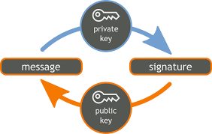

Digital Signature System
Digital Signature is a security mechanism system in the cyberspace for digital data processing and their transformation. It requires keys, public and private key, which are used to encrypt messages before transmission and decrypt them on receipt time using the hash algorithm.
The digital signature allows records for Electronic Data Interface (EDI) in various e-sectors for the data transformation, such as email, e-business, e-banking, etc.
The Electronic Signatures in Global and National Commerce Act of the USA is one of the parts of cyber law.

Slide 12

Freedom of Expression (Telecommunication Law)
The transmission and reception of information of any type, including data, television pictures, sound, and facsimiles, using electrical or optical signals sent over wires or fibers or through the air is called telecommunication.
Cyberspace does not only cover the Internet and computers, but it also covers those places where two or more cables or wires meet.
So, telecommunication systems also come in the field of cyberspace and they are also a necessary part of the cyber law.

Slide 13
International Cyber law
At first, America started making the laws as follows.
Fair credit reporting Act in 1970 – This law has made provision of the rights to see one’s own credit record without paying.
Freedom of Information Act in 1970 – The right provided by the state to the public to see the information.
Video Privacy Protection Act in 1988 – No one can see and use the other’s personal record without the court’s order.
Copyright Act 1992 – The law to stop unauthorized copy. The penalty is 5 years in custody and a fine of US dollar 250,000.

Slide 14
Cyber law of Nepal
“The Electronic Transaction and Digital Signature Act-Ordinance” is popularly known as “Cyber law” of Nepal.
The government of Nepal has passed his law on 30th Bhadra 2061 Bs (15 September 2004).
This law has provided new trust to the Information Technology (IT) sector, and IT professional are hopeful that it will create a favorable situation for conducting IT business.
The major interesting provisions of this Act are:
Provision of legal status to digital signatures, electronic record for introducing e-banking, e-shopping, e-commerce, etc.
Provision for license regarding the IT customers and their duties and responsibilities.

Slide 15
Provision of punishment to a hacker who damages programs or data residing in other computer or network or illegally copies them.
Likewise, the interpretation of the service of network facilities, telecommunication and their obligation, duty service and clarification have been mentioned.

Slide 16
The Electronic Transactions Act, 2063 (2008)
Act number 27 of the year 2063
It is expedient to make, legal provisions for authentication and regularization of the recognition, validity, integrity and reliability of generation, production, processing, storage, communication and transmission system of electronic records by making the transactions to be carried out by means of electronic data exchange or by any other means of electronic communications, reliable and secured;
For controlling the acts of unauthorized use of electronic records or of making alteration in such records through the illegal manner,
There are twelve chapters with a total of 80 sections described in it.

Slide 17
Provisions Relating to Electronic Record and Digital Signature (chapter 2)
Authencity of Electronic Record –
(1) Any subscriber may, subject to the provisions of this section, authenticate to any electronic record by his/her personal digital signature.
(2) While authenticating the electronic record pursuant to Sub-section (1), an act of transforming such electronic record to other electronic record shall be effected by the use of asymmetric crypto system and hash function.
(3) Any person may verify the electronic record by using the public key of the subscriber.

Slide 18
Offence Relating To Computer (chapter 9)
44. To Pirate, Destroy or Alter computer source code: If a person pirates, destroys, alters computer source code to be used for any computer, computer programme, computer system or computer network or cause, other to de so, he/she shall be liable to the punishment with imprisonment not exceeding three years or with a fine not exceeding two hundred thousand Rupees or with both.
45. Unauthorized Access on Computer Materials: Punishment with the fine not exceeding Two Hundred Thousand Rupees or with imprisonment not exceeding three years or with both depending on the seriousness of the offence.
47. Publication of illegal materials in electronic form: (1) If any person publishes or displays any material in the electronic media including computer, internet which are prohibited to publish or display by the prevailing law or which may be contrary to the public morality or decent behavior or any types of materials which may spread hate or jealousy against anyone or which may jeopardize the harmonious relations subsisting among the people of various castes, tribes and communities shall be liable to the punishment with the fine not exceeding One Hundred Thousand Rupees or with the imprisonment not exceeding five years or with both.

Slide 19
(2) If any person commit an offence referred to in Sub-section (1) time to time he/she shall be liable to the punishment for each time with one and one half percent of the punishment of the previous punishment.
52. To commit computer fraud: If any person, with an intention to commit any fraud or any other illegal act, creates, publishes or otherwise provides digital signature certificate or acquires benefit from the payment of any bill, balance amount of any one's account, any inventory or ATM card in connivance of or otherwise by committing any fraud, amount of the financial benefit so acquired shall be recovered from the offender and be given to the person concerned and such an offender shall be liable to the punishment with a fine not exceeding one hundred thousand Rupees or with an imprisonment not exceeding two years or with both.

Slide 20
Situation in Nepal
Before 2066 BS, despite the presence of Cyber law, it was rarely implemented.
Main Reason: The Police Investigations got stuck due to lack of proper technologies and political influences.
Currently, The Police Officials have specially designed Digital Forensic Lab with about 735 more technical police persons.
The lie detection tools and DNA profiling technologies and many other Digital Intelligence technologies adopted from the USA, helps identify email gateways, data extraction, analysis and reporting, by maintaining the integrity of digital evidences.
Our main challenge however, is the political influences in the cyber crimes.
About 3-5 years back, SSP Rana Bdr. Chand of that time used GPS tracker to trace the goons but failed due to the contacts with political leader.

Slide 21
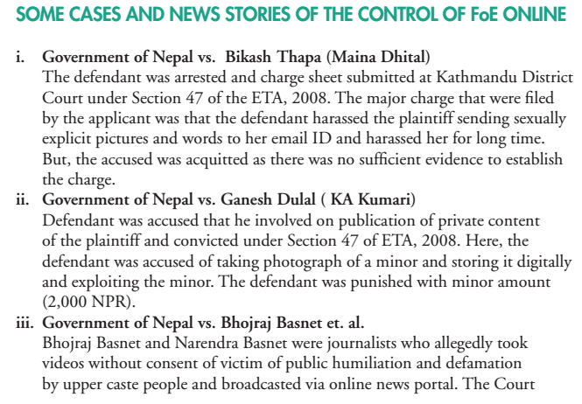
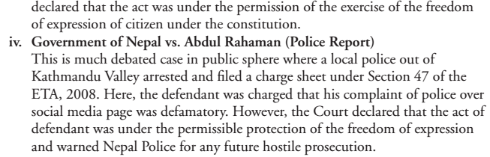
Notes:
Use of Section 47 that prevents publishing inappropriate materials

Slide 22
Advantages of Cyber law
Following are the advantages of cyber laws 1. Secured E-commerce for Setting Online Business. 2. Digital Certificate for securing site. 3. Blocking unwanted content from Internet. 4. Proper monitoring of traffic. 5. Security Against common frauds. 6. Born of new Security Agencies like Cyber Cell. 7. Software as well as Hardware security.
Penalizes offenders of cybersex and sexual harassments
Offenders of these crimes are now subjected to punishment under the provisions of the law. The rights of the children, especially the victims of this law, are further protected due to the Cybercrime Law
Protects the people from cyberbullying.
Notes:
Traffic-DOS
Fraud- ATM
Bully- hepne

Slide 23
Provisions in the Cybercrime Law are meant to protect individuals and groups from libellous claims that are meant to attack them. The law concerns not only incidents of cyberbullying, but also other instances similar to that.
Provisions in the law punish cyber squatters.
This provision assists in deterring cyber squatters. That is, anyone who owns and misuses a certain domain(for example, a company website), and uses it for illegal and personal gain. Cyber squatters deceive people into support their own personal gain
Deters online identity theft
. Identity theft online is now penalized by the law. This provision protects the individual’s privacy and protection as well. There are many ventures in which an individual’s identity may be attained online, which prompted the provision of this section.
Notes:
Cyber squatters- cyber bata illegal kaam garne
Deters – id card /citizenship ni fake banaune

Slide 24
Disadvantages of cyber law
Ambiguous Terms.
Important terms in the law are not clearly defined. This is dangerous as it may have various degrees of interpretation. For example, online libel does not define, as to whether or not certain situations are consider edlibellous. Ambiguous terms may also be found in the provision for Real time collection of data, etc.
Threatens Freedom of Speech.
The ambiguity of the provisions, particularly the online libel, can cause people to be wary of what they say online. The exposition of the truth may be seen as libellous, depending on the way it is treated. In short, people are subconsciously being restrained by the law. Even if the freedom of speech is not unlimited, the law still inhibits somehow, those individuals that want to speak out. There is a fear that any negative comment and criticism may be seen as an “attack,” and can be used against them
Maintenance of the Law.
The implementation and execution of the Cybercrime Law would alone cost the Philippines P 50,000,000 a year. Not to mention the actual prosecution of it. The Cybercrime law, deals with delicate subject matters, and must be handled with balance and objectivity in order to make it work.

